Slide 1
CS2001 Group Project
Team 7
Gunn Hannah 1520853/1
THOMPSON MIAH-GEORGE 1406990/1
BUSHRA Mohamed 1508904/1
ALRASHIDI FALEH 1512279/1
FAROOQ MUHAMMAD 1540977/1
GUIRUNG BINOD 1516552/1

Slide 2
Presentation Overview

Slide 3
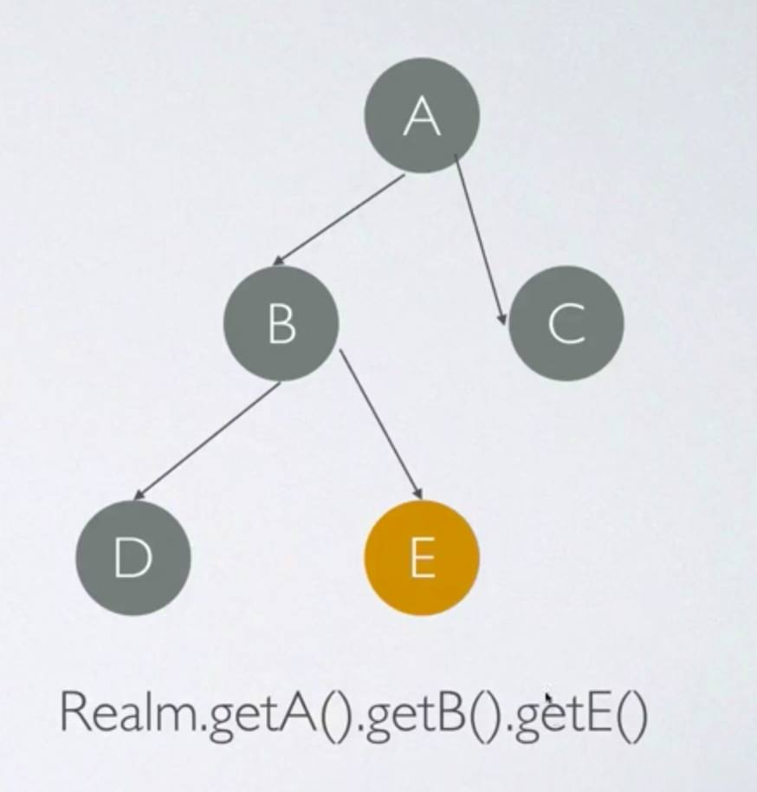
The Android Database: REALM – why?
Add reasons: Watch this with team:
https://www.youtube.com/watch?v=x_5Ifs8kIrI

Slide 4
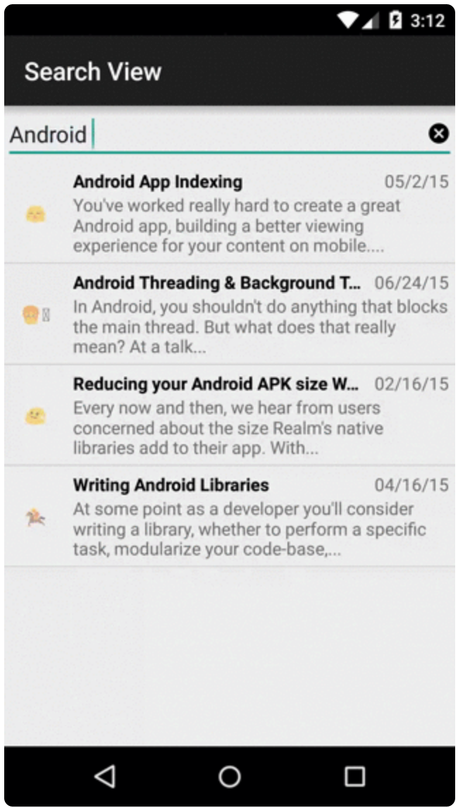
The Search Library: RealmSearchView
A library that renders a search bar and result list.
works in combination with:
RealmSearchAdapter
runs a text search against a Realm object class and shows the results.
supports “as-you-type search”

Slide 5

Simple to use
RealmSearchView is available as a gradle dependency:
Once that is done and assuming that the database is built with RealObjects, one needs to create a custom SearchAdapter.
The search is very fast due to the optimisations of the Realm database.

Slide 6
Thanks for your attention!
Questions?

Slide 7
References
Youtube: 209 Android Realm Tutorial | coursetro.com
Building an Android Search Controller, by Thorben Primke on Nov 6 2015
Github: A Search View with Result list powered by Realm

